Slide 1
Lab 1: Introduction to Statistics and Data Analysis
University of Michigan
Physics Department
Mechanics and Sound Intro Labs

Slide 2
Welcome to the
Intro Physics Labs
The idea of a physics lab may seem daunting at first, but once you get started, you will find that they can be quite enjoyable. That’s also the reason we made these slides for you; to help you adequately prepare for each lab before you get to your lab session.

Slide 3
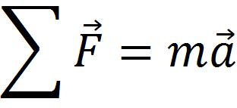
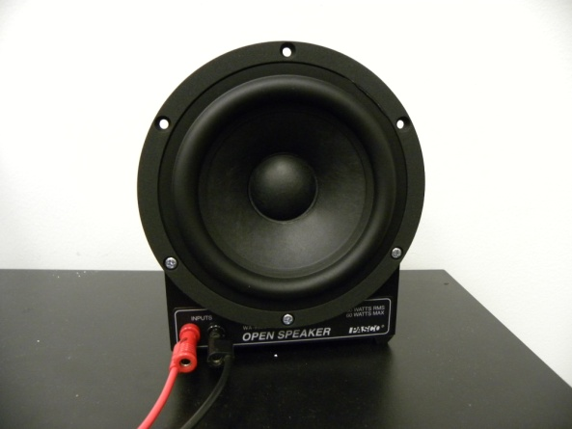
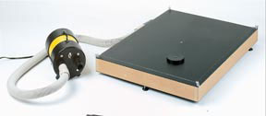
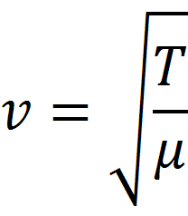
In these slides, you will be given a brief introduction to the concepts that you will explore in each lab, and more importantly, a short overview of the equipment that you will use. So let’s get started!
These slides and your lab manual will help to explain these concepts. Soon these equations will be meaningful and accessible! You will also learn how to use the equipment pictured and many other devices.

Slide 4
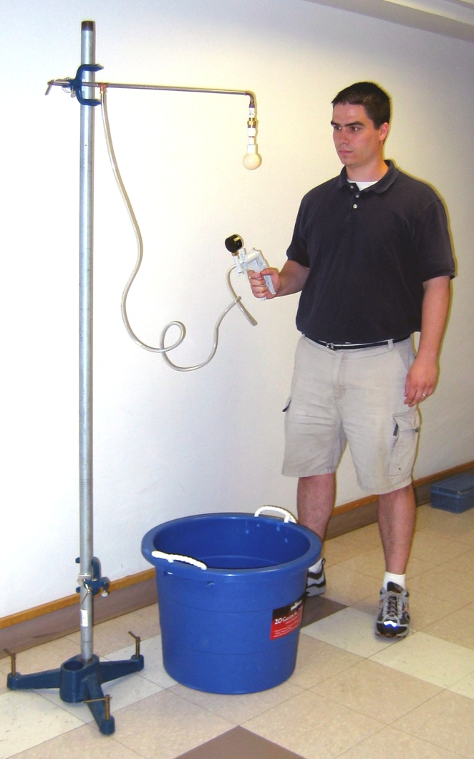
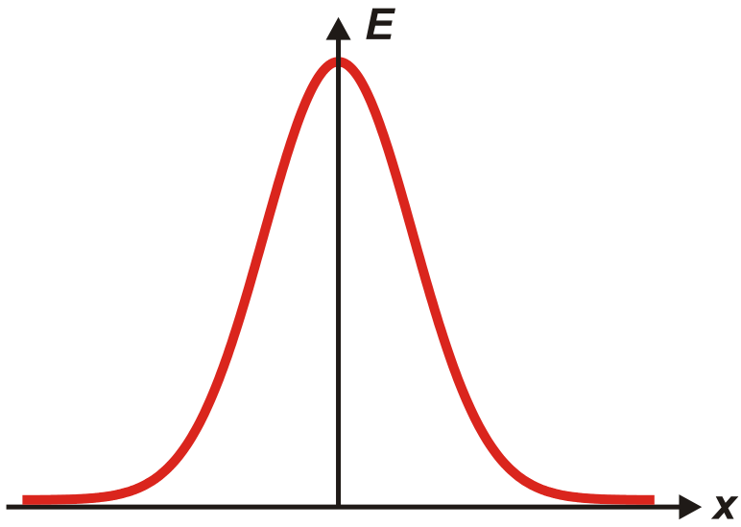
Statistics and Data Analysis

Slide 5
Lab 1 is designed to introduce you to several important concepts in statistics and data analysis. You will be able to find a full discussion of commonly used statistical methods in your lab manual. Be sure to familiarize yourself with them before you get to class. If you find any of the concepts to be confusing, just ask your GSI for help. It’s what the GSI’s are there for.

Slide 6
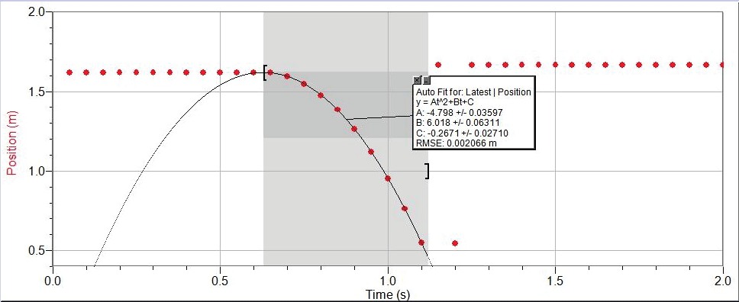
You will notice that this lab class is largely “paper free”, that is, your lab work will be done on a computer and submitted electronically at the end of each lab period. You will make extensive use of both Excel® and Logger Pro® software programs. If you are unfamiliar with either program, don’t worry, you will lean them quickly as you progress through this class. In addition, there are short tutorials with tips and suggestions available from the course web page.
A typical Logger Pro® plot window.

Slide 7
← The vacuum release system used in this lab. The ultrasonic sensor is inside the bucket.
When you get to the lab classroom, the data collection instruments, in this case a sonic ranger will be set up for you. You will use a vacuum release system to drop a ball over the sonic ranger. The sensor tracks the position of the ball as a function of time using sound waves.

Slide 8
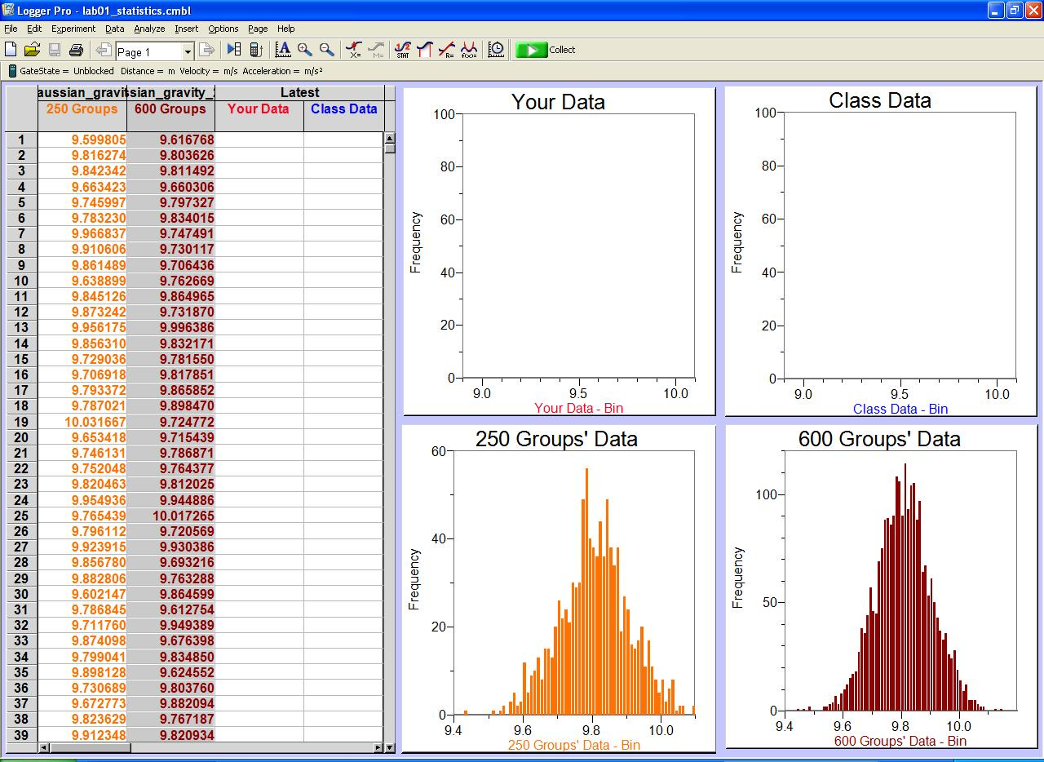
The lab procedure involves using the hand pump to hold a ball above the sensor, starting the data acquisition, and releasing the ball with the trigger on the hand pump. The analysis is up to you. Have fun!
This screen is an example of a Logger Pro® template used for analysis in this lab class→
See you in the lab!

